Slide 1
Wireless Networks
Lecture 11
Fundamentals of Cellular Networks (Part I)

Slide 2
Introduction
Early mobile system objective was to achieve a large coverage using single high power antenna
Impossible to reuse the same frequencies in the same coverage area.
For example, Bell mobile system in 1970 could support maximum of 12 simultaneous calls over a thousand square mile.
The Govt regulatory could not make spectrum allocation proportion to the increasing demand
Became imperative to restructure the telephone system to achieve high capacity with limited radio spectrum.

Slide 3
Cellular Concept
Cellular concept was a major breakthrough in solving problem of spectrum congestion and user capacity
Offers high capacity without any major change in technology
Replacing high-power transmitter (large cell) with many low-power transmitter (small cells) each providing service to small
Each BS is allocated a portion of the channels.
Nearby BS are assigned different group of channels
So that all the available channels are distributed among the nearby BS.
May be reused as many times as necessary as long as the BS using same channels are not in overlapping.

Slide 4
As the demand for service increases, the number of BS can be increased with reduced transmission power.
Thereby providing additional capacity with no addition to spectrum.
This is the foundation of for all modern wireless communication systems.

Slide 5
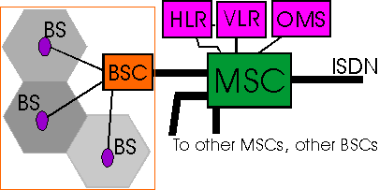
AMPS Architecture

Slide 6
Frequency Reuse
Relies on intelligent allocation and reuse of channels.
A small geographical area with allocation of a group of channels is called cell.
BS antennas are designed to achieve the desired coverage within a cell avoiding co-channel interference.
The design process of selecting and allocating channel groups for all the cellular BS is called frequency reuse or frequency planning.

Slide 7
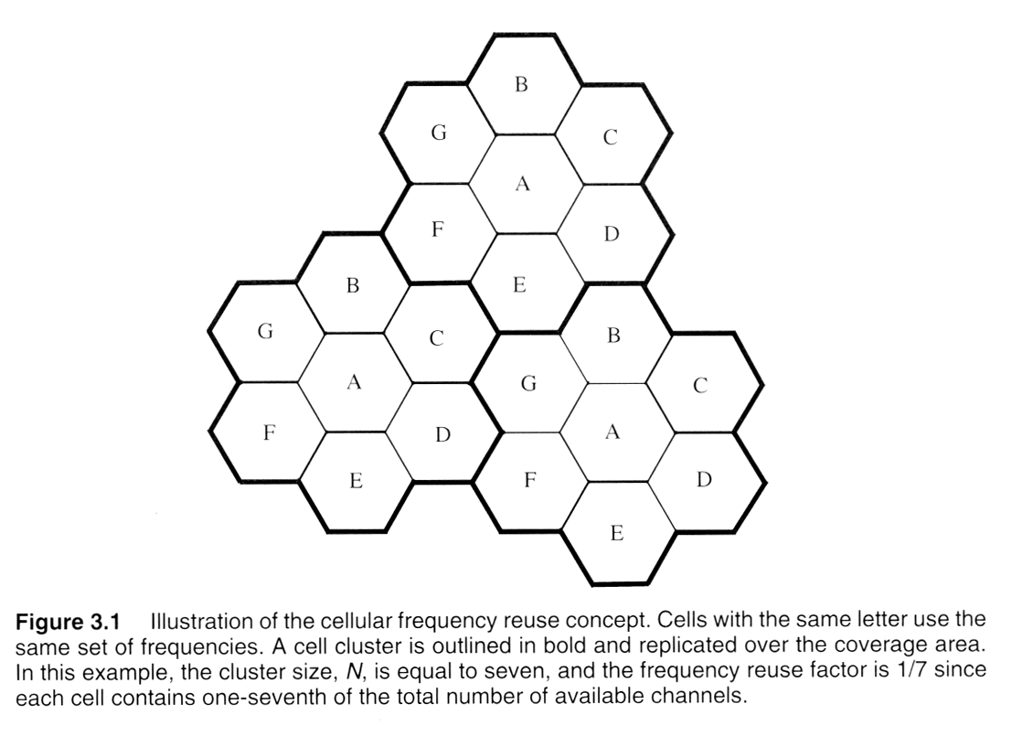

Slide 8
The hexagonal shape representing a cell is conceptual and simplistic model of coverage.
The actual radio coverage is known as the footprint and is determined from field measurement, propagation prediction models
However a regular shape is needed for systematic system design and adaptation to future growth.
It might be natural to choose a circle to represent coverage but adjacent circles cannot be overlaid upon a map without leaving gaps or creating overlapping.

Slide 9
Gaps
Overlapping
Case A
Case B

Slide 10
Three possible choices of shapes: square, equilateral triangle and hexagon.
For a give distance between the center of a polygon and its farthest perimeter points, the hexagon has the largest area of the three
Thus by using hexagon geometry, the fewest number of cells can cover a geographic region and it closely approximates circle.

Slide 11
Capacity of System
When using hexagon to model coverage areas
Center-excited Cell: BS depicted as being either in the center of the cell
Omni-directional antenna is used
Edge-excited Cell: on three of the six cell vertices
Sectored direction antenna is used
Consider a cellular system
which has S duplex channels available for reuse.
Each cell allocated group of k channels (k < S)
S channels divided among N cells (unique and disjoint) then
S = kN

Slide 12
Cluster: N cells, which collectively use the complete set of available frequencies
If a cluster is replicated M times in the system, the number of duplex channels C as a measure of capacity is
C = MkN = MS
So capacity is directly proportional to the replication factor in a fixed area.
Factor N is called cluster size and is typically equal to 4, 7, 12.

Slide 13
If cluster size N is reduced while cell size is kept constant
more clusters are required
More capacity is achieved
Large cluster size indicates that co-channel cells are far from each other
Conversely, small cluster size means co-channel cells are located much closer together
The value of N is a function of how much interference a mobile or BS can tolerate

Slide 14
Clusters are inversely proportion to N
Capacity is directly proportional to Clusters
Thus frequency reuse factor is given by 1/N.
In last fig, each hexagon has exactly six equidistant neighbors and that the lines joining the centers of any cell and its neighbors are separated by multiple of 60 degrees.
There are only certain cluster sizes and layouts possible

Slide 15
Locating co-channel neighbors
To connect hexagons without gaps,
The geometry of hexagon is such that the number of cells per cluster N can only have values
N = i² + ij + j²
where i and j are non-negative integers.
To find out the nearest co-channel neighbors of a particular cell, do the following
Move I cells along any chain of hexagon
Then turn 60 degree counter clockwise and move j cells

Slide 16
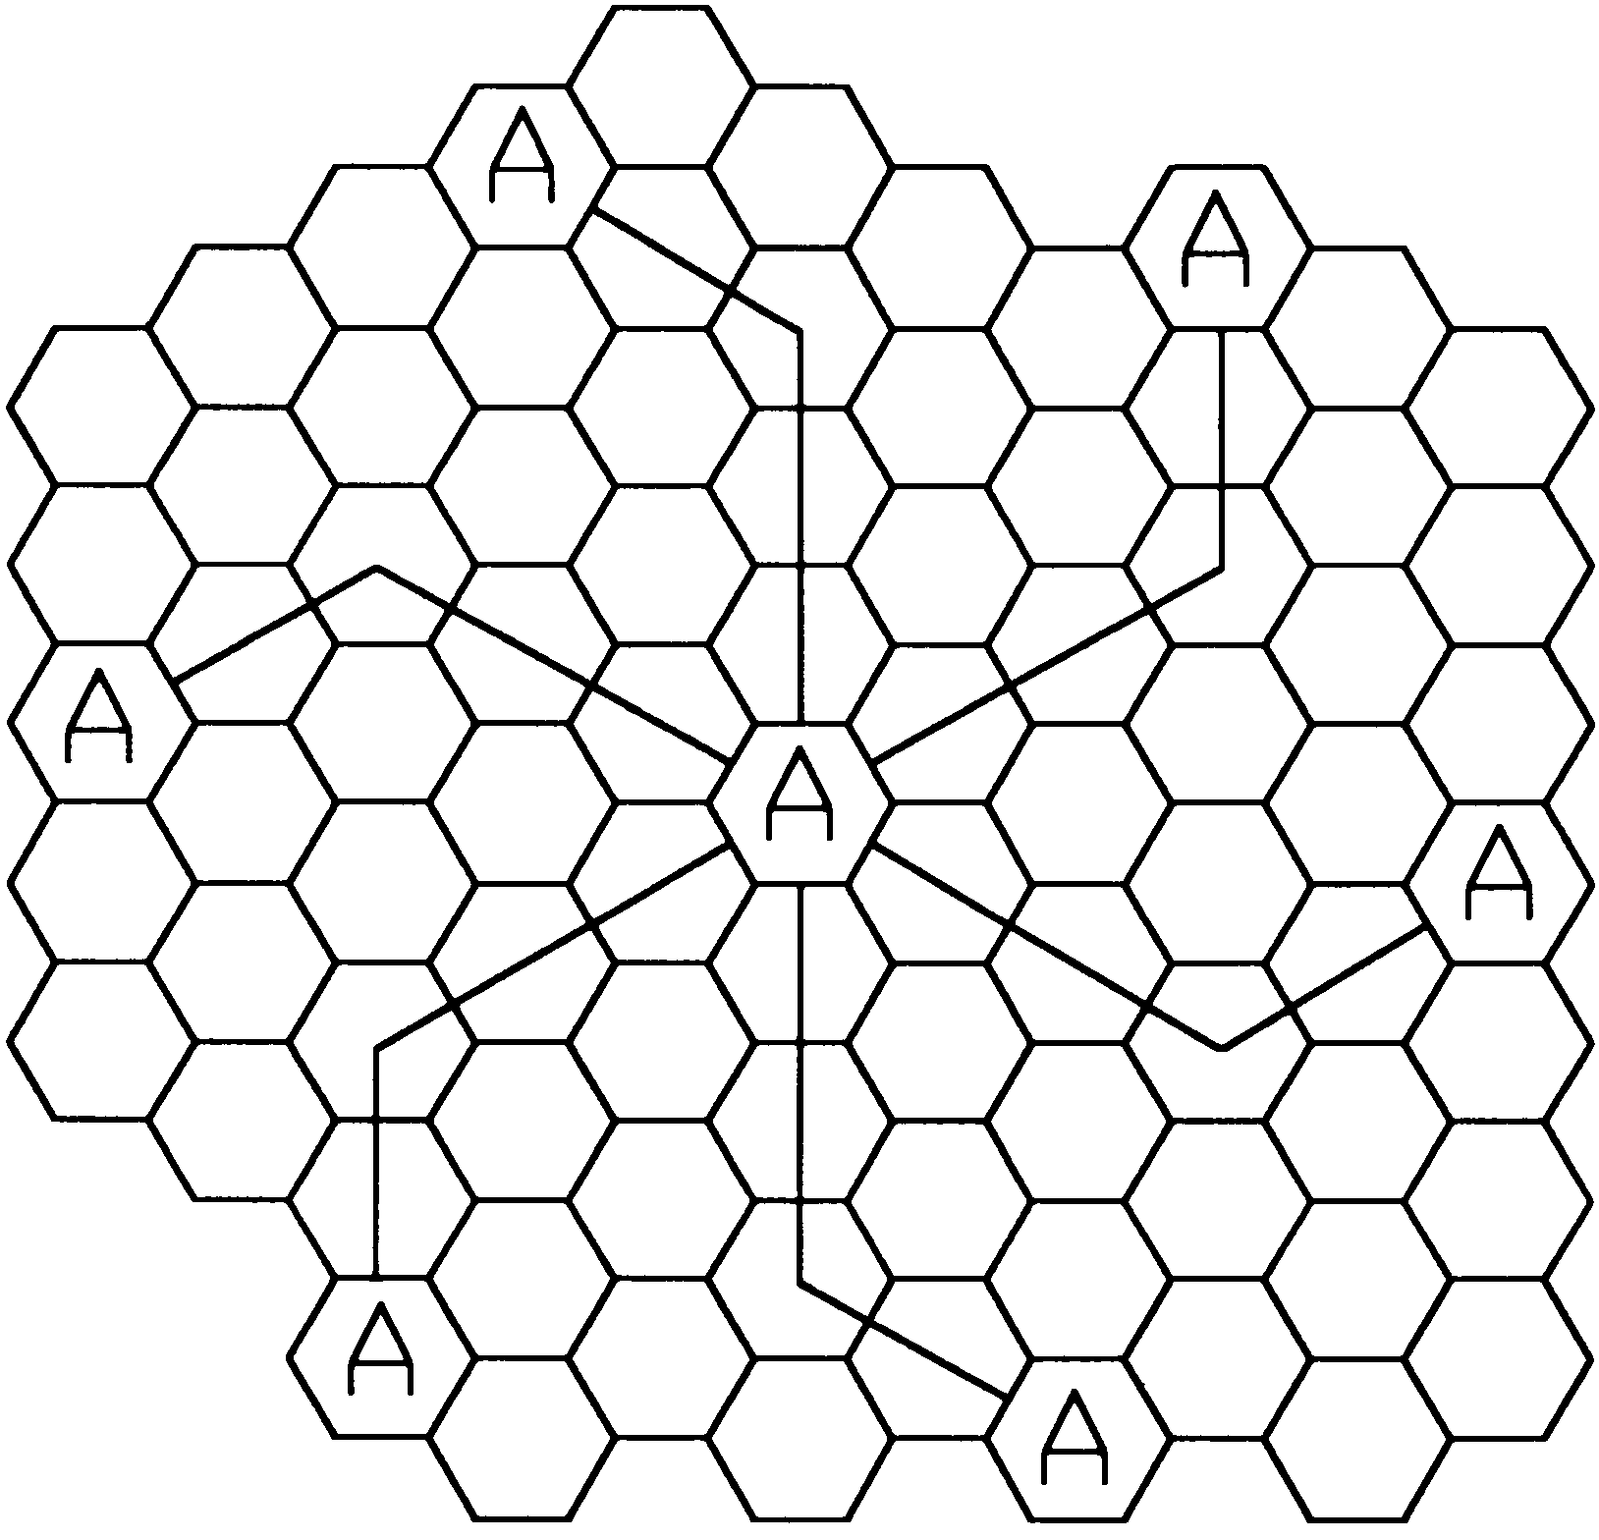
Example: Locating co-channel cells
In this example N=19, i=3, j=2

Slide 17
Example
BW = 33 MHz allocated to particular FDD cellular system, where two 25 KHz simplex channel to provide full-duplex for voice/data.
Compute the number of channels per cell if a system uses
Four-cell reuse
Seven-cell reuse
Twelve-cell reuse.
If 1 MHz is dedicated to control channels, determine equitable distribution of control and voice channels per cell for above three systems?

Slide 18
Solution: Part I
TotalBW = 33 MHz,
ChannelBW = 25 KHz x 2 = 50 KHz/duplex channel
S = 33,000 / 50 = 660 channels
For N = 4
k = 660 / 4 ≈ 165 channels
For N = 7
k = 660 / 7 ≈ 95 channels
For N = 12
k = 660 / 12 ≈ 55 channels

Slide 19
Solution: Part II
Sc = 1000 / 50 = 20 channels
Sv = S – Sc = 660 – 20 = 640 channels
For N=4,
5 control channels + 160 voice channel.
For N=7,
4 cells with 3 control + 92 voice channels
2 cells with 3 control + 90 voice channels
1 cell with 2 control + 92 voice channels
In practice, 1 control/cell and 4x91 + 3x92 voice channels
For N = 12,
8 cells with 2 control + 53 voice channels
4 cells with 1 control + 54 voice channels
In practice, 1 control and 8x53 + 4x54 voice channels

Slide 20
Summary
Cellular Concept
Frequency Reuse
Locating co-channel cells
Example
Next Lecture
Handoff Strategies
Interference and System Capacity

